Slide 1
Project Overview and SDG Alignment
Name:KARTIN WANJALA MACHANJA School: POWER LEARN PROJECT

Slide 2
Introduction
This project aims to address a critical issue: water scarcity in rural areas. By focusing on Sustainable Development Goal 6 (SDG 6), we are contributing towards ensuring availability and sustainable management of water and sanitation for all.
Our solution uses a data-driven approach to analyze water usage and distribution patterns, aiming to optimize resource allocation and prevent shortages.
The project specifically targets the inefficiencies in water distribution systems in rural communities, which often suffer from unequal access to clean water.

Slide 3
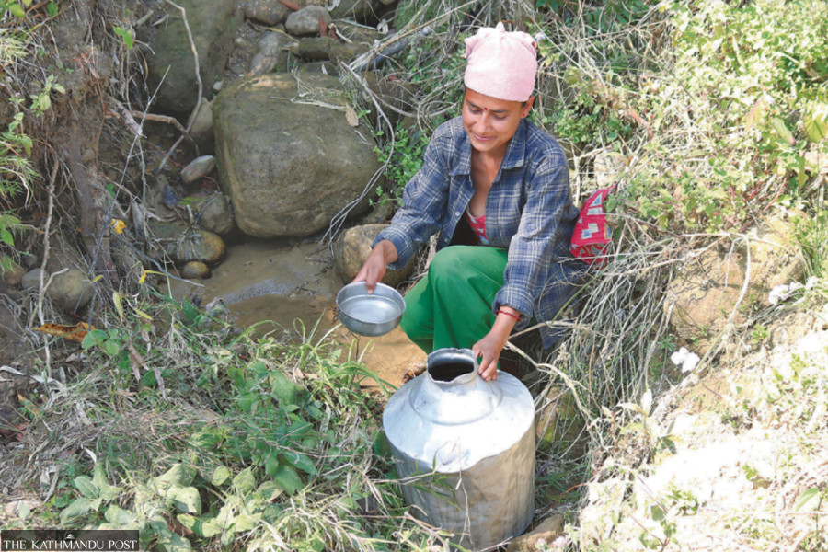
Problem Definition and Significance: Water Scarcity in Rural Areas
Problem Definition: Many rural areas suffer from a lack of sufficient and reliable access to clean water. Despite available water resources, poor distribution systems result in some regions receiving less water than they need, while others experience wastage.
Goal: The project seeks to use data to analyze where water shortages occur and how resources are being distributed. The idea is to develop a model that highlights inefficiencies and suggests better allocation based on demand and need.
Significance: Water is a vital resource, and unequal distribution can lead to serious public health, agricultural, and economic challenges in rural areas. By addressing this problem, we aim to promote fair access to water and improve the quality of life for these communities.

Slide 4
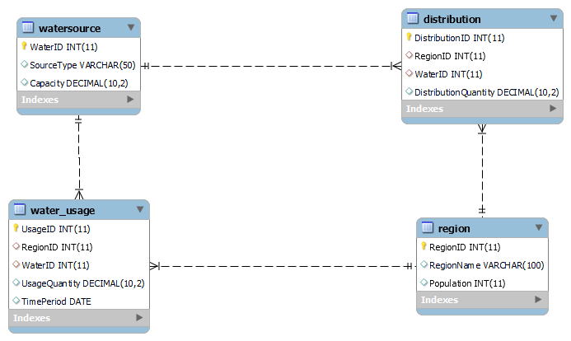
Database Structure Overview
The data model for this project consists of several key entities that represent the main components of the water distribution system: Water Source, Distribution, Usage, Region, and Time Period.
Each water source (e.g., wells, rivers) is tracked in the system, along with how much water it distributes to different regions over time.
The Region entity stores demographic information about the areas receiving water, such as population size, to better understand the water needs of each location.
This structure allows for detailed tracking and analysis, enabling us to pinpoint where water is being under or over-distributed and suggest corrective actions.

Slide 5
SQL Query Examples for Data Analysis
One of the key processes in this project involves using SQL queries to retrieve relevant data from our database. For example, we wrote queries to calculate the total amount of water distributed to each region, enabling us to see which areas are receiving more or less water than they require.
Another query focused on analyzing water usage by region, helping us identify regions with high or low water consumption.
These SQL queries form the backbone of our data analysis, allowing us to extract meaningful insights from large datasets and better understand the dynamics of water distribution and usage.

Slide 6
Water Distribution Insights
Our analysis revealed significant disparities in water distribution across regions. For instance, some rural areas received far less water than needed relative to their population, while urban regions often received more than necessary.
Rural regions like Area A and Area B were identified as suffering the most from water scarcity. This was due to inefficient water distribution, with large amounts of water being allocated to urban regions with lower demand.
These insights suggest that reallocation of resources is necessary to ensure more equitable distribution, allowing all regions to meet their water consumption needs.

Slide 7
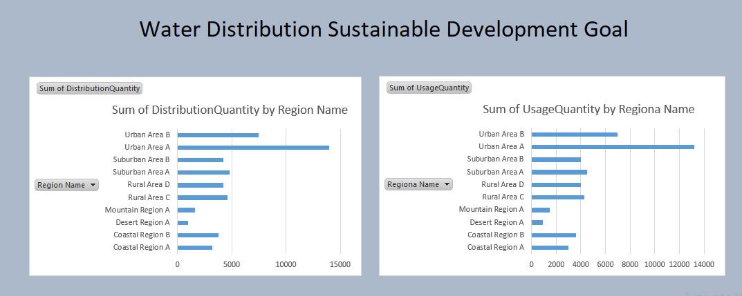
Excel Dashboard Demonstration
We created an interactive Excel dashboard to visualize the key data insights. The dashboard allows stakeholders to see real-time data on water usage and distribution across regions.
The dashboard features charts and graphs that make it easy to compare the amount of water distributed versus the amount of water actually used in each region. This helps decision-makers quickly identify problem areas.
The tool also includes filters that allow users to view data for specific time periods, water sources, or regions, making it a flexible and valuable resource for managing water distribution more effectively.

Slide 8
Water Usage by Region
One of the visualizations we developed was a comparison of water usage across different regions. This visualization allows us to clearly see which regions have the highest and lowest water consumption.
This analysis is crucial for understanding the demand for water in each area, and it also highlights inefficiencies, such as regions receiving more water than they use.
With this information, we can make more informed decisions about how to allocate water resources, ensuring that regions with higher consumption receive sufficient water while reducing waste in areas with lower demand.

Slide 9
Recommendations for Improving Water Distribution
Based on our data analysis, we recommend reallocating water resources to ensure that rural areas with higher populations and higher water consumption are prioritized.
We also suggest implementing real-time water monitoring systems in rural areas. This would allow for dynamic adjustments to water distribution based on actual usage patterns, reducing waste and shortages.
Going forward, we recommend integrating predictive analytics into the system. This would enable better forecasting of water demand, allowing for proactive management of water resources in anticipation of changing needs.

Slide 10
Integration and Technical Workflow
The workflow for this project involves several key steps. First, data is collected from water distribution systems and stored in a relational database. SQL queries are then used to retrieve and analyze this data.
The results of the SQL queries are exported to Excel, where we use pivot tables and charts to visualize the data.
We also used Excel’s VLOOKUP function to automate the process of mapping IDs (such as RegionID and WaterID) to their corresponding names, streamlining the analysis process and ensuring accuracy.

Slide 11
Project Summary and Future Outlook
In summary, this project demonstrates how data-driven solutions can help address water scarcity in rural areas. By analyzing water distribution and usage patterns, we identified key inefficiencies and proposed practical solutions to improve resource allocation.
This approach can be scaled to other regions and even applied to different sectors, such as agriculture or energy.
Looking ahead, we plan to integrate predictive analytics and IoT technologies into the system, which would allow for real-time monitoring and adjustment of water distribution. This would further enhance the efficiency and sustainability of water resource management.

